Slide 1
Slide Set 3
Inheritance: Derived Class declaration, Public, Private and Protected Inheritance, friend function and Inheritance, Overriding member function, Forms of inheritance, virtual base class, Abstract class, Constructor and Inheritance, Destructor and Inheritance, Advantage and disadvantage of Inheritance.

Slide 2

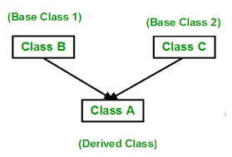
Inheritance - one class acquires the members of another class

Slide 3
Derived Class declaration
class A : public B, public C {
…
};
// we use public most of the time (explained ahead)

Slide 4

class Base {
protected: int i;
public: Base(int a){i=a;}
void baseShow() {cout<<"i="<<i<<endl;}
};
class Child : public Base {
int j;
public: Child(int a, int b) : Base(a) {j=b;}
void childShow(){cout<<"i="<<i<<",j="<<j<<endl;}
};
int main(void) {
Base b(55); b.baseShow();
Child c(10,20); c.childShow();
}

Slide 5
Output
i=55
i=10,j=20

Slide 6
Access specifier
Access | public | protected | private
Same class | ✔ | ✔ | ✔
Derived classes | ✔ | ✔ | ❌
Outside classes | ✔ | ❌ | ❌

Slide 7
Three modes of inheritance
Public
Protected
private

Slide 8
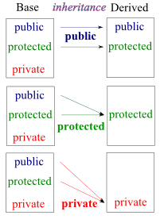


Slide 9
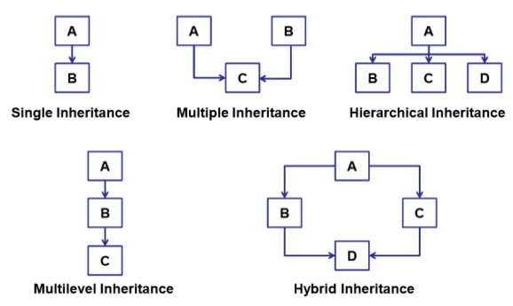
Types of inheritances in C++

Slide 10
Friend function and Inheritance
Friendship is not inherited
What is the output of the following program?

Slide 11
class A {
protected: int i;
public: A(int a) { i = a;}
friend void show();
};
class B: public A {
int j;
public: B(int a, int b) : A(a) {j=b;}
};
void show() {
B b(-2,55);
cout<<b.i<<", "<<b.j; }
int main() {show();}

Slide 12
Output
[Error] 'int B::j' is private
So parent’s friend is not child’s friend,
what about vice versa?

Slide 13

Overriding member function
It is like creating a new version of an old function, in the child class.

Slide 14
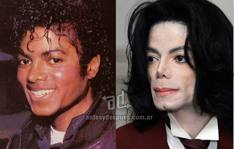
class Base {
public: void disp(){cout<<"Base"<<endl; }
};
class Derived: public Base{
public: void disp(){cout<<"Derived"<<endl; }
};
int main() {
Derived d;
d.disp(); }

Slide 15
Virtual base class
They are used to prevent the confusion or duplicity among child classes during inheritance.
Consider the following situation:

Slide 16
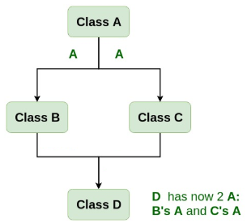


Slide 17
class A {
public: void show() {cout<<"In A"<<endl;}
};
class B : public A {};
class C : public A {};
class D : public B, public C {};
int main() {D d; d.show(); }

Slide 18
Output
[Error] request for member 'show' is ambiguous
Need virtual keyword to fix this error

Slide 19

class A {
public: void show() {cout<<"In A"<<endl;}
};
class B : public virtual A {};
class C : public virtual A {};
class D : public B, public C {};
int main() {D d; d.show(); }

Slide 20
Abstract base class - interface
It describes the capabilities of a C++ class without committing to a particular implementation
A class is made abstract by declaring at least one of its functions as pure virtual function i.e. by placing "= 0" in its declaration

Slide 21
class Animal{
public:
virtual void sound() = 0;
void sleeping() {cout<<"Sleeping"; }
};
class Dog: public Animal{
public:
void sound() {cout<<"Woof"<<endl;}
};
int main(){
Dog obj; obj.sound(); obj.sleeping();
}

Slide 22
Output: Woof Sleeping

Slide 23
class Animal{
public:
virtual void sound() = 0;
void sleeping() {cout<<"Sleeping"; }
};
class Dog: public Animal{
public:
void sound() {cout<<"Woof"<<endl;}
};
int main(){
Animal *obj = new Dog;
obj->sound();
}

Slide 24
Output: Woof

Slide 25
Constructor order
Base class constructors are always called first in the derived class constructors.
For multilevel inheritance, constructors are called in the order of inheritance

Slide 26
Order of execution
Method of inheritance
A(); base constructor
B();derived constructor
B(); base(first)
C(); base(second)
A(); derived
class B:public A {
};
class A:public B, public C
{
};

Slide 27
Destructors order in inheritance
Destructors are called in reverse order as that of constructors
class A:public B, public C {…};
Order of execution of constructors and destructors:
~A();
~C();
~B();

Slide 28
Pros and cons of inheritance
Reuse the methods and data of a class
Extend the existing class by adding new data and functions
Modify the existing class by overloading its methods
Adds extra memory overload for the compiler as it has to keep records of the parent as well as the child class

